Slide 1
Non-linear Mixed Models in PK: A NONMEM Tutorial
Carolyn Clayton
Committee Members: Samantha MaWhinney, Laura Saba, Jennifer Kiser

Slide 2
PK Models: History
Problem: Need individual dosing recommendations based on drug concentrations
Solution: Sheiner and Beal proposed NLME in 1972
NONMEM released in 1980
Sheiner and Beal published term “Population Pharmacokinetics” in 1981
Davidian and Giltinan published review of NLME literature in 2003
10/10/16: 1,992 journal articles in JSTOR mention NONMEM
24,978 mention nonlinear mixed model
Notes:
The history of Pharmacokinetic models begins with a problem. In the late ‘60s and early ‘70s, Lewis Sheiner needed to analyze warfarin and dioxin therapies while developing individual dosing recommendations.
He and Stuart Beal proposed using NLME for pharmacokinetic analysis, specifically for use in simulations, in 1972, but it wasn’t until 1977 that they were able to conduct and report a study specifically designed to utilize NLME.
However, there were some issues with acceptance of NLME in the statistical community. NONMEM was initially designed only for the 1977 dataset, and even though it was more adaptable when it was released commercially, the estimates it returned were biased in certain situations. In addition, the term Sheiner and Beal coined and used in a paper in 1981, “Population Pharmacokinetics”, led some statisticians to believe that individual data variation was not taken into account, and that applications outside of pharmacokinetics were limited.
Some pharmacokineticists, on the other hand, were skeptical that population characteristics could be estimated from a sparse dataset (with only 2 or 3 observations per individual). NLME had the reputation of being a way to try to rescue poorly gathered data, and it was only after multiple studies designed to use NLME were published that the method gained wider acceptance.
Davidian and Giltinan published a review of NONMEM literature and explained some of the statistical methodology behind the estimation methods.
Now: Info from JSTOR search for “NONMEM” and “nonlinear mixed model” with content type: “Journals” searched on www.jstor.org on 10/9/2016.
All info from Goonaseeland Mentre Steimer, except for “NONMEM released in 1980”, which is from the ICON website.

Slide 3
PK Models: PK vs PD
Pharmacokinetics: Body → Drug
Pharmacodynamics: Drug → Body
Absorption
Distribution
Metabolism
Excretion
Mechanism
Efficacy
Adverse effects
Dose-response curves
Notes:
Info from: http://www.icr-global.org/EasysiteWeb/getresource.axd?AssetID=1488 and http://www.ashp.org/doclibrary/bookstore/p2418-chapter1.aspx

Slide 4
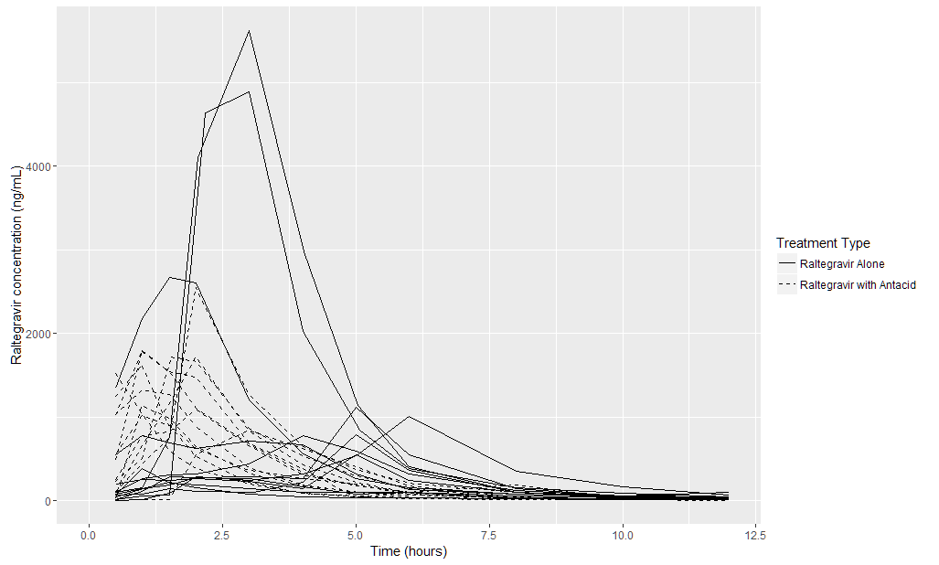
PK Models: Background
Notes:
Continuous outcome (drug concentration) measured over time
Nonlinear in the covariates
Focusing on one and two compartment models

Slide 5
PK Models: Uses
Phase I Drug Trials (Traditional PK)
Phase III Drug Trials (Population PK)
Intensive sampling
Small sample size, generally healthy and adherent
Few covariates
Initial estimates of PK parameters
Sparse sampling
Large sample size
Study covariate effects
Minimize toxicity
Increase efficacy
Develop dosing regimens

Slide 6
PK Models: One- and Two-compartment Models
Administration Site
Absorption
Body
Elimination
Flow C to P
Administration Site
Absorption
Central Compartment
Peripheral Compartment
Flow P to C
Elimination
Notes:
When the perfusion rates are slow enough that the central compartment contains a clinically significant concentration of the drug, a two compartment model may be desired.
Central compartment may include the blood, kidneys, and liver.

Slide 7



PK Models: One-compartment Model
Notes:
a1 is the amount at the absorption site at a given time, a1 at time 0 is dose, and a2 is the amount in the peripheral compartment at a given time. Ka is the absorption rate constant, V is the body volume, and Cl is the rate of drug clearance from the body. The instantaneous change in drug concentration is given by da1/dt and da2/dt for the absorption site and the peripheral compartment, respectively.
Talk about what is known and what needs to be estimated

Slide 8


PK Models: Two-compartment Model
Notes:
When the perfusion rates are slow enough that the central compartment contains a clinically significant concentration of the drug, a two compartment model may be desired.
Note Cl/V (compartments) change to Cl/Vc

Slide 9











Linear Mixed Models
time
study condition
intercept and patient characteristics
fixed effect coefficients
random effect coefficients
residual error
fixed effect subject values
random effect subject values
Notes:
Xi is based on a combination of ui and ai. Zi is based on ai and commonly allows for a random intercept and slope for each subject but does not necessarily have to include all the covariates from ai. In simple models, Zi may simply include a random intercept
When the error term and random effects are included, the equation precisely describes the responses for each individual.
When the error term is omitted, the predicted response of subject is described
When the random effects are also excluded, the predicted mean response of the sample given a set of fixed effects values is represented
Thus, in a linear model the average of all modeled individual curves is the predicted population curve for a given set of fixed effects values. Note that in nonlinear models, discussed later, this is not the case

Slide 10
Linear Mixed Models: Fixed and Random Effects
Fixed Effect
Random Effect
Does not vary between subject
Include:
Primary explanatory variable
PK Parameters
Other covariates
Varies between subject
Allows correlation between observations and partial pooling
Captures between-subject variability
May be dropped for simplicity
Include:
PK Parameters
Covariates
Notes:
If the between-subject variability is large, a random effect may be useful
If between-subject variability is relatively small, random effect may be assumed to be zero and dropped for simplicity, although models with and without the random effect should be compared to check that there is no significant difference in fit.

Slide 11



Linear Mixed Models: Link Functions
Outcome not normal
Categorical
Dichotomous
Nonnegative
Relationship between outcome and predictors not linear but can be linearized through transformation
General Form
Cumulative Logit
Log link
Notes:
Outcome is not normal. E.g. categorical, dichotomous, or nonnegative
If outcome is ordinal (e.g. adherence level of subjects categorized by low, medium, high), may use cumulative logit transform. In this equation, r is the ordinal category of interest out of k total categories. Thus, you need k-1 cumulative logit models to sufficiently describe the sample. Even though, once the outcome is back-transformed to original scale, the relationship is not linear, Beta and b are linear with the transformation so it is considered a linear model.
If outcome is nonnegative with high variation (e.g. CD4 counts), a log link for a Poisson distribution may be used. mu is the vector of expected number of CD4 cells for an individual per unit of time; this expected number may change over time if time is included as a covariate. Similarly, Beta and b are still linearly related to the transformed outcome.

Slide 12
Nonlinear Mixed Models
Could fit the dose concentration curves with linear model (e.g. polynomial, b-spline), but parameter estimates are not interpretable
With the differential equations, parameters have clinical significance
Able to assess effects of covariates on parameters of interest (e.g. Cl, V, Ka)

Slide 13




Nonlinear Mixed Models: Equations
PK parameters may be function of random effects or covariates
Notes:
We talked about the solved equation a moment ago, but there is another layer of complexity. Each parameter can have covariates and random effects associated with it.
Random effects also allow the effect for an individual to be influenced by the mean effect if the individual has few observations. Random effects may also be chosen if there is a high degree of variability between subjects.
Partially pool = combine

Slide 14




Model Selection: Base Model
Begin with a simple base model
Choose between compartment structures
Assess which PK parameters should include random effects
Compare models via change in OFV (if nested) or AIC (if not nested)
Example:
Model A: 8 parameters, OFV = 3000
Model B: 6 parameters, OFV = 3050
Notes:
Note: Look at 2 real models and make sure bigger model has smaller OFV.
Due to the complexity of nonlinear mixed models and corresponding difficulties with convergence, it is generally recommended to begin model selection with a simple base model, which usually does not have any covariates.
You may begin with random effects on all PK parameters and narrow down by removing the random effect with the smallest variance.
Since 50 is larger than 5.992, the OFV difference is considered significant, and Model A should be chosen because the two missing parameters in Model B significantly decrease model fit.
If there is no significant difference between models, the simpler model is recommended for ease of convergence in later steps.

Slide 15
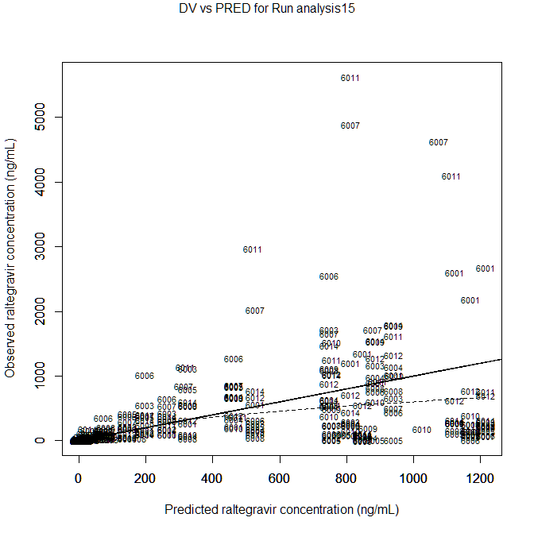
Model Selection: Base Model
DV vs PRED
Overall goodness of fit
Proximity and symmetry of points about 1:1 diagonal line

Slide 16
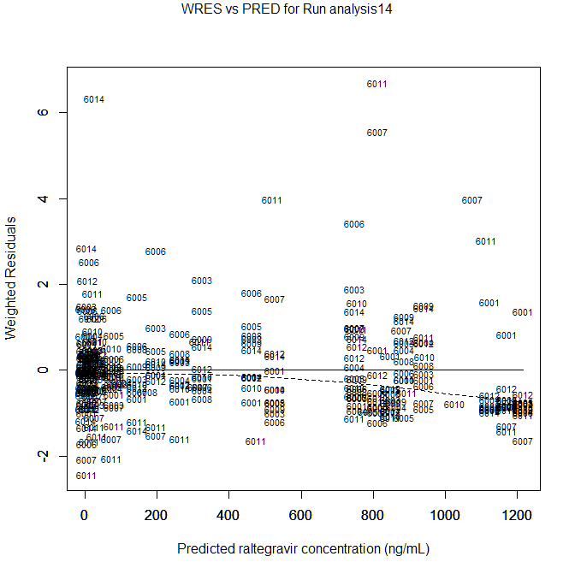
Model Selection: Base Model
WRES vs PRED
Overall goodness of fit
Symmetrical distribution about 0 with no trend
Some outliers may be present
U shape indicates additional compartment needed
If most points below 0 and few points above 0, may indicate log transform needed

Slide 17
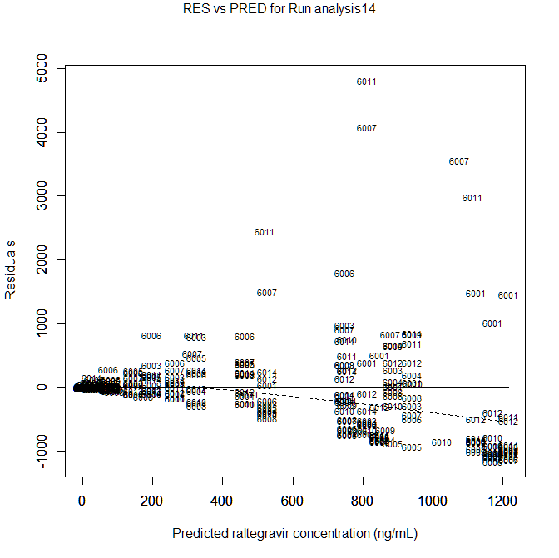
Model Selection: Base Model
RES vs PRED
Goodness of fit of residual error structure
Constant spread indicates additive
Increasing spread indicates proportional

Slide 18

Model Selection: Covariates
Chosen because:
Primary explanatory variable
Biological Rationale
Group Effect
Merit assessed by:
Change in OFV or AIC
Graphical analysis
Percent relative reduction in between-subject variability
Starting values for PK parameters may be obtained from the base model
Notes:
primary explanatory variable (e.g. treatment)
because there is a biological rationale for inclusion (e.g. it is known that kidney function has an effect on clearance rate)
or to assess a group effect (e.g. to determine whether volume varies significantly between males and females)
where omega is the variance of the random effect of the parameter on which the covariate is placed

Slide 19
Model Selection: Covariates
Dichotomous covariate structures
Additive shift (linear): unit increment or decrement associated with the non-reference group
Proportional shift: proportional increment or decrement associated with the non-reference group
Categorical covariate structures
Similar to dichotomous, with individual parameters and indicator variables for each non-reference group
Notes:
The model fit should not change for a proportional vs additive shift; only the interpretation.

Slide 20
Model Selection: Covariates
Continuous covariate structures
Linear: PK parameter increases or decreases linearly with the covariate
Power: PK parameter increases or decreases nonlinearly with the covariate (linearly in a natural log transformation). Flexible
Exponential: Similar to power. Also flexible, but provides different shapes from Power
Piece-wise Linear: Linear relationship between PK parameter and covariate changes at an inflection point. This point may be fixed based on the data, or estimated as part of the model.

Slide 21
NONMEM: Data Format
Recommend .csv file format
Path to data file must not contain spaces
Data should be in long format (i.e. one row per observation)
Maximum of 20 columns
Missing values are replaced by zeros in the analysis!
Notes:
File path to data file must not contain spaces (including the name of the data file itself)

Slide 22
NONMEM: Data Format
C |  | Data Desc: Raltegravir Dataset
C | ID | TREAT | TIME | DV | AMT | sex | race | weight | height | age | EVID
 | 6001 | 1 | 0 | . | 400000 | 0 | 0 | 63.25 | 65.5 | 33 | 1
 | 6001 | 1 | 0.5 | 1349 | 0 | 0 | 0 | 63.25 | 65.5 | 33 | 0
 | 6001 | 1 | 1 | 2179 | 0 | 0 | 0 | 63.25 | 65.5 | 33 | 0
 | 6001 | 1 | 1.5 | 2670 | 0 | 0 | 0 | 63.25 | 65.5 | 33 | 0
 | 6001 | 1 | 2 | 2603 | 0 | 0 | 0 | 63.25 | 65.5 | 33 | 0
 | 6001 | 1 | 3 | 1206 | 0 | 0 | 0 | 63.25 | 65.5 | 33 | 0
 | 6001 | 1 | 4 | 560 | 0 | 0 | 0 | 63.25 | 65.5 | 33 | 0
 | 6001 | 1 | 5 | 268 | 0 | 0 | 0 | 63.25 | 65.5 | 33 | 0
 | 6001 | 1 | 6 | 153 | 0 | 0 | 0 | 63.25 | 65.5 | 33 | 0
 | 6001 | 1 | 8 | 77.3 | 0 | 0 | 0 | 63.25 | 65.5 | 33 | 0

Slide 23
Example Data from First Three Subjects

Slide 24
NONMEM: Data Format
Rows sorted by ID then TIME
TIME is relative (time since initial observation)
DV = outcome
AMT = dose amount (0 at times when dose is not given)
MDV = missing dependent variable (1 when observation recorded, 0 when not – e.g. dosing time)
EVID = event id (1 when observation recorded, 0 when not, 4 to reset all compartments – use in crossover designs)

Slide 25
NONMEM: Projects / Data Tab
Create project by clicking Add New
Recommend creating a new file folder
Must re-select project each time PDx-POP is re-opened

Slide 26
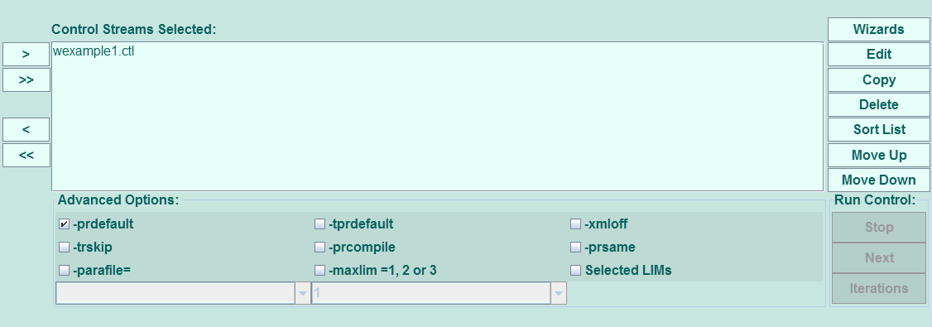
NONMEM: Model / Run Tab
Control stream – file of code that specifies which model will be run with which options
Must be moved into the Control Streams Selected box in order to run
Created by manually typing code, or through a wizard
Create duplicate by pressing Copy
Can be edited in any text editor
Notes:
Wizards create the skeleton of a control stream through a check-box interface, and then the control stream can be fine-tuned after creation.
If a control stream is created is “Saved As” under a new name instead of “Copied”, the project may need to be re-selected under the Projects / Data tab in order to refresh the Control Streams Available list.

Slide 27
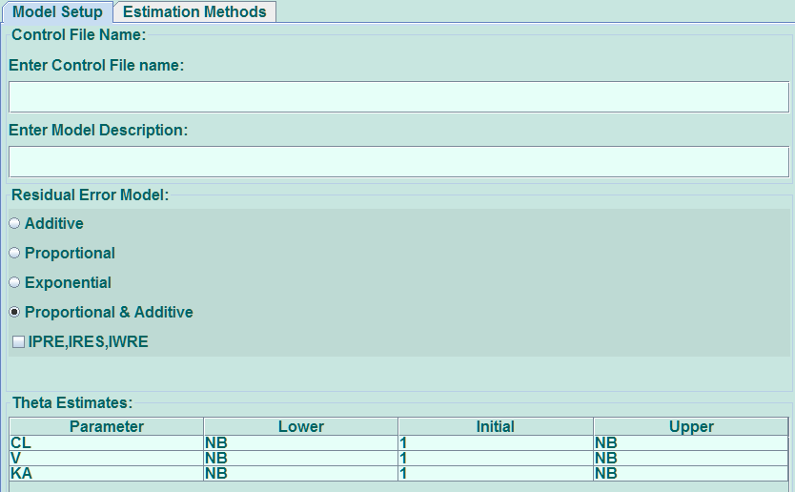
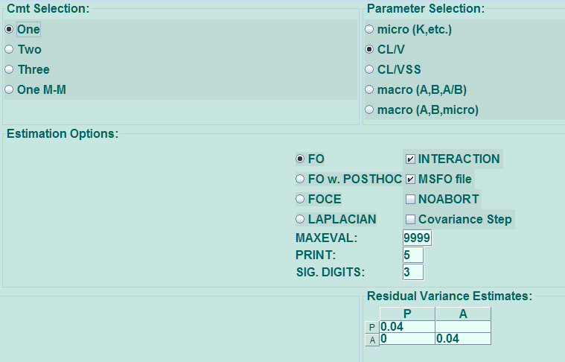
NONMEM: Wizard

Slide 28
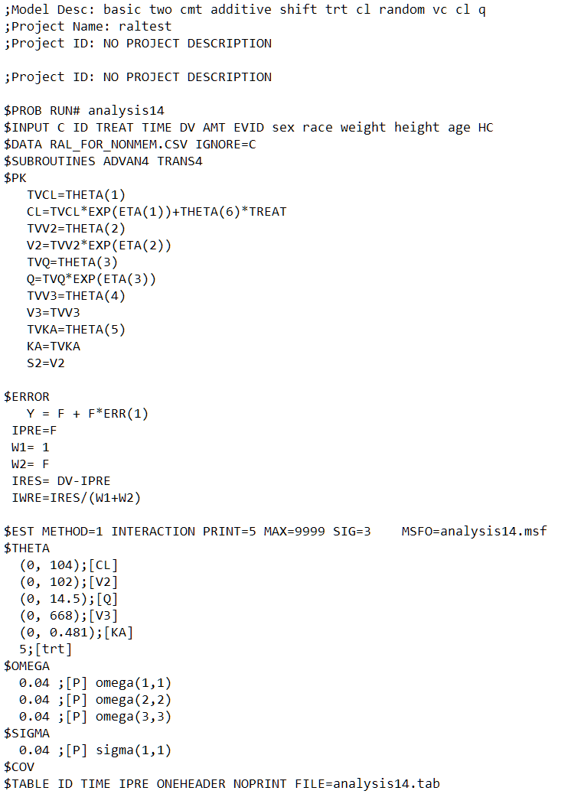
NONMEM: Control Stream
Records begin with $
Comment indicated by ;
Order of records not restricted

Slide 29
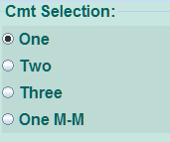
NONMEM: $SUBROUTINES Record
Wizard: Chosen under Cmt (Compartment) Selection
One compartment linear elimination: ADVAN2
Two compartment linear elimination: ADVAN4

Slide 30
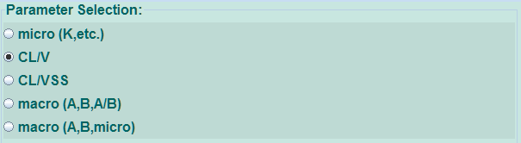
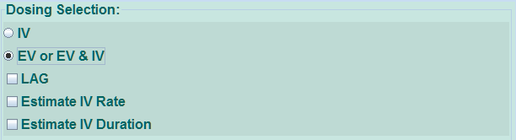
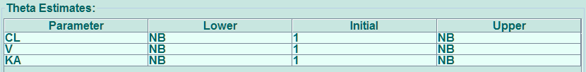
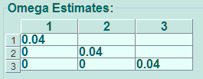
NONMEM: $PK, $THETA, and $OMEGA Records
Wizard:
Parameter Selection
Dosing Selection
Theta Estimates
Omega Estimates

Slide 31
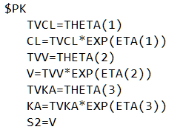


NONMEM: $PK, $THETA, and $OMEGA Records
Dichotomous covariates:
Additive (linear): CL=TVCL*EXP(ETA(1))+THETA(2)*SEX
Proportional: CL=TVCL*EXP(ETA(1))*(1+THETA(2)*SEX)
Exponential: CL=TVCL*EXP(ETA(1))*EXP(THETA(2)*SEX)
If statements
Categorical covariates:
CL=TVCL*EXP(ETA(1))+THETA(2)*RACEB+THETA(3)*RACEC
Notes:
Fixed effects = Theta
Random effects = Eta

Slide 32
NONMEM: $PK, $THETA, and $OMEGA Records
Continuous covariates:
Linear: CL=TVCL*EXP(ETA(1))+THETA(2)*WEIGHT
Power: CL=TVCL*EXP(ETA(1))*(WEIGHT**THETA(2))
Exponential: CL=TVCL*EXP(ETA(1))*EXP(THETA(2)*WEIGHT)
Piece-wise linear: If statements
The symbol ** indicates an exponentiation
Notes:
** indicates an exponentiation

Slide 33
NONMEM: $PK, $THETA, and $OMEGA Records
Continuous covariates may need to be median-centered
e.g.: CL=TVCL*EXP(ETA(1))+THETA(2)*(WEIGHT-70)
Categorical covariate groups may need to be combined

Slide 34
NONMEM: $PK, $THETA, and $OMEGA Records
Starting values
If only initial estimate, code will appear as 64;[CL]
If lower bound added, (0, 64);[CL]
If upper bound added, (0, 64, 120);[CL]
Lower bound may be specified by itself, but upper bound requires lower bound
Lower and upper bounds should not be set for covariates
Varying the starting values of the $OMEGA record may aid in model convergence
If a random effect (ETA) is removed, the corresponding $OMEGA entry must also be removed

Slide 35
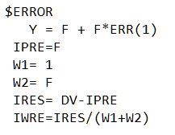

NONMEM: $ERROR and $SIGMA Records
F = individual predicted concentration
ERR = residual error
SIGMA = variance of the residual error
IRES and IWRE allow individual predictions and weighted residuals to be calculated for diagnostic plots

Slide 36
NONMEM: $ERROR and $SIGMA Records
Structures:
Additive: Y=F + ERR(1)
Proportional: Y=F + F*ERR(1)
Additive and Proportional: Y=F + F*ERR(1) + ERR(2)
A SIGMA entry should exist for each ERR

Slide 37
NONMEM: $ EST Record
PK parameters may be function of patient-specific covariates and/or random effects
The likelihoods, which we would normally maximize, are complex and analytically intractable, so we must rely on approximations.
FO: $EST
FOCE: $EST METHOD=1
Laplace: $EST METHOD=1 LAPLACIAN

Slide 38
NONMEM: $EST Record – FO
First-order
The first estimation method developed
Estimates fixed effects, but does not estimate random effects
Random effects are estimated posthoc
Short computation time, but can be biased
Used in model-building when there are a large number of models or the models are complex
Notes:
Random effects are estimated to be zero.

Slide 39
NONMEM: $EST Record - FOCE
First-order Conditional Estimation
Estimates fixed and random effects by maximizations within maximizations
Less biased than FO, especially if:
The model is nonlinear
There is multiple dosing
There is large inter-individual variability

Slide 40
NONMEM: $EST Record - Laplacian
Most general method
Not widely used
May be computationally intensive
May be less biased than FO or FOCE
Notes:
Not widely used in the literature, although at this point we are not sure why. It may be that it was a method proposed by Sheiner and Beal that never became popular.

Slide 41
Example Data: Raltegravir
Absorption of raltegravir varies based on food intake and gastric pH
Antacid affects pH
Intensive sampling dataset
12 subjects measured 13 times in 48 hours
At 0.5, 1, 1.5, 2, 3, 4, 5, 6, 8, 10, 12, 24, 48 hours
Crossover design – each subject received raltegravir alone and raltegravir with antacid

Slide 42
Example Data: Raltegravir
Notes:
Continuous outcome (drug concentration) measured over time
Nonlinear in the covariates
Focusing on one and two compartment models

Slide 43
Example Data: Raltegravir
Step 1: Base Model
Simple one- and two-compartment models were compared
Starting values obtained from previous publication (Arab-Alameddine, 2012)
Models were compared with change in OFV or AIC, as appropriate
Within each model, it was determined which PK parameters should have random effects
A two-compartment model with random effects on Cl, Vc, Q, and Ka was chosen.
Notes:
Previous publication: Arab-Alameddine, et al (2012)
Models were built with random effects on all parameters (or as many parameters as possible, if a full model would not converge), then the random effect with the smallest random effect variance estimate was removed, and OFV was compared

Slide 44
Example Data: Raltegravir
Step 2: Add Treatment
Linear and exponential treatment was tried on Cl, Vc, Vp, and Ka using the model from Step 1 as the base model
Updated starting values were obtained from parameter estimates in Step 1
A couple of models had lower AIC than the model chosen, but only partially converged or were not well-behaved
A two-compartment model with random effects on Cl, Vc, Q, and Ka, linear treatment on Cl was chosen

Slide 45
Example Data: Raltegravir
Step 3: Add Weight
Linear and exponential weight was tried on Cl, Vc, and Vp using the model from Step 2 as the base model
Although a couple of models had lower AIC than the model from Step 2, they were not well-behaved
The model from Step 2 with random effects on Cl, Vc, Q, and Ka, linear treatment on Cl was chosen as the final model

Slide 46
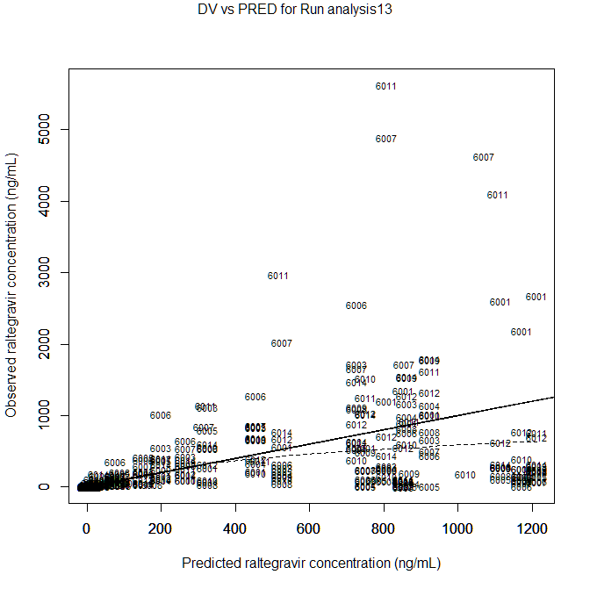
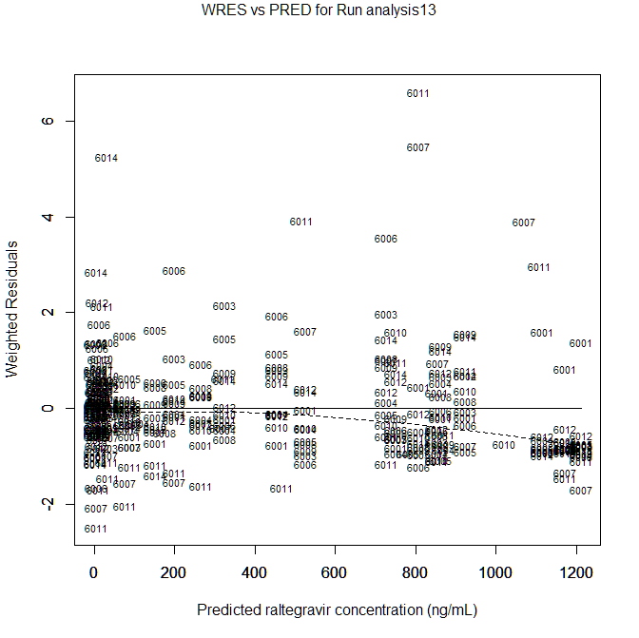
Example Data: Raltegravir

Slide 47
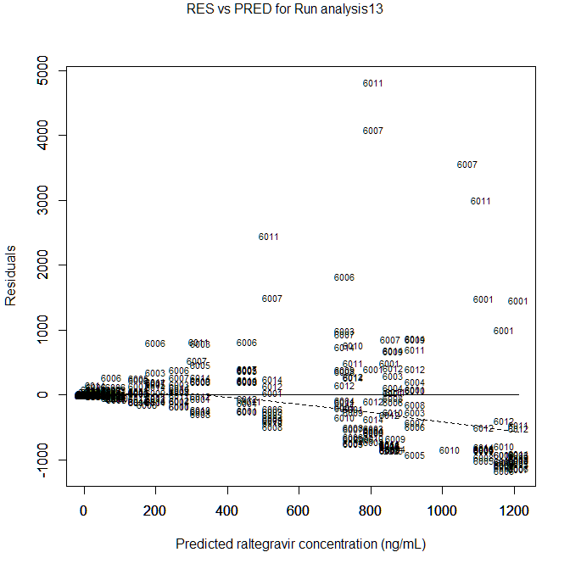
Example Data: Raltegravir

Slide 48



Example Data: Raltegravir
The addition of treatment offered a significant improvement in fit versus a model without
Unexplained inter-individual variance in Clearance was reduced by 7.744% in the model with treatment versus a model without
Clearance varied significantly by treatment; subjects on RAL with antacid had a clearance estimate 50.8 mL/hr higher than subjects on RAL alone (95% CI 38.3, 63.3).
Clearance (mL/hr) | Absorption (hr⁻¹) | Central Compartment Volume (mL) | Peripheral Compartment Volume (mL) | Inter- Compartmental Clearance (mL/hr) | Linear Treatment on Clearance (mL/hr)
76.6 (49.2, 104) | 0.597 (0.443, 0.751) | 95.9 (47.9, 144) | 374 (83.9, 664) | 11.5 (5.37, 17.6) | 50.8 (38.3, 63.3)

Slide 49
Thank you

